Slide 1


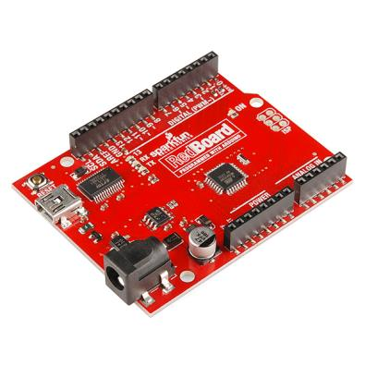
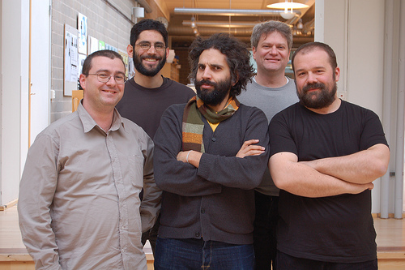
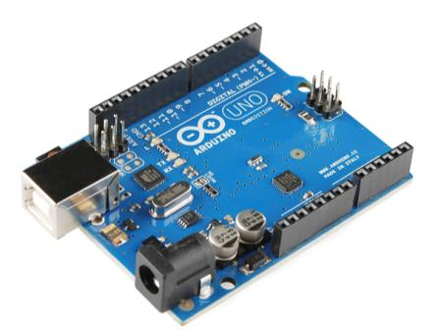
Arduino Board
The Arduino project started at the Interaction Design Institute Ivrea (IDII) in Ivrea, Italy.The Wiring platform consisted of a printed circuit board (PCB) with an ATmega168 microcontroller, an IDE based on Processing and library functions to easily program the microcontroller. In 2003, Massimo Banzi, with David Mellis, another IDII student, and David Cuartielles, added support for the cheaper ATmega8 microcontroller to Wiring. But instead of continuing the work on Wiring, they forked the project and renamed it Arduino.

Slide 2
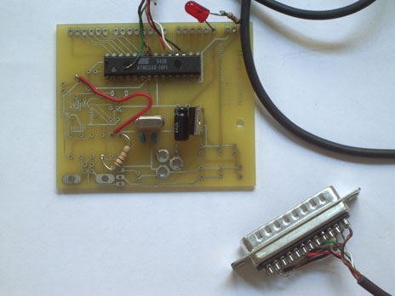
Arduino…
is the go-to gear for artists, hobbyists, students, and anyone with a gadgetry dream.
rose out of another formidable challenge: how to teach students to create electronics, fast.
http://spectrum.ieee.org/geek-life/hands-on/the-making-of-arduino

Slide 3
Getting Started
Check out: http://arduino.cc/en/Guide/HomePage
Download & install the Arduino environment (IDE)
Connect the board to your computer via the USB cable
If needed, install the drivers
Launch the Arduino IDE
Select your board
Select your serial port
Open the blink example
Upload the program

Slide 4
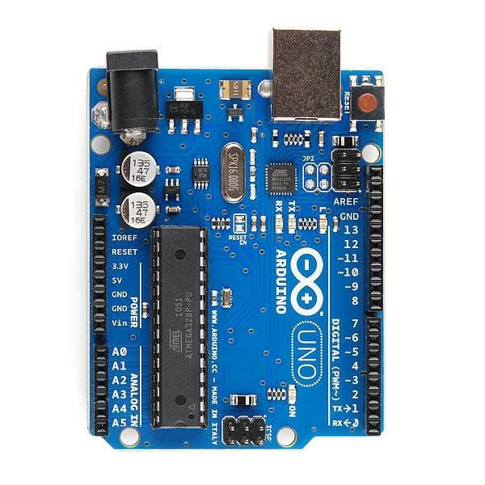
PWR IN
USB
(to Computer)
RESET
SCL\SDA
(I2C Bus)
POWER
5V / 3.3V / GND
Digital I\O
PWM(3, 5, 6, 9, 10, 11)
Analog INPUTS
Notes:
Look up analog ref

Slide 5
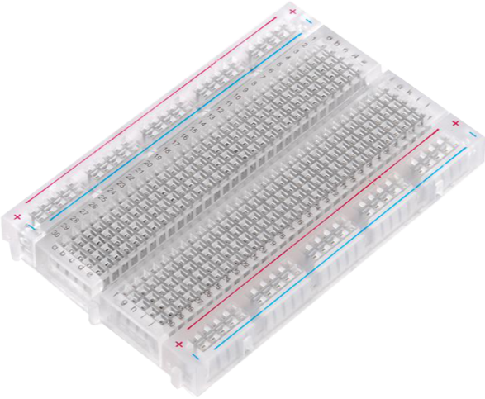
Prototyping Circuits Solderless Breadboard
One of the most useful tools in an engineer or Maker’s toolkit. The three most important things:
A breadboard is easier than soldering
A lot of those little holes are connected, which ones?
Sometimes breadboards break

Slide 6
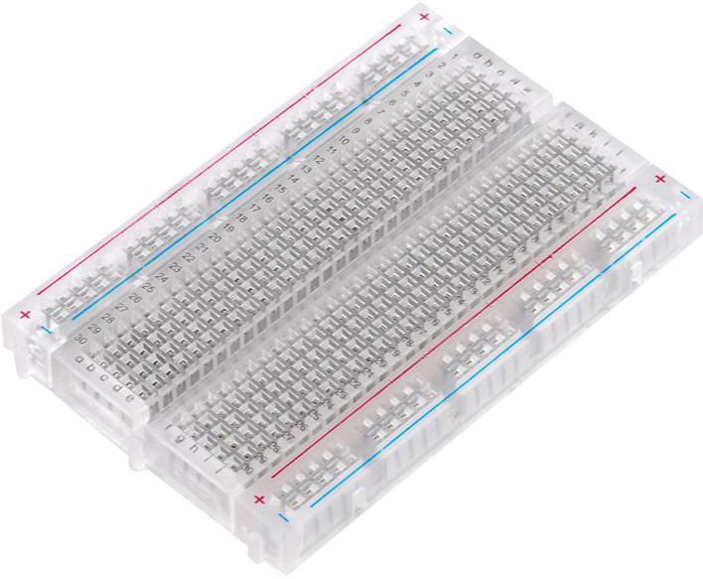
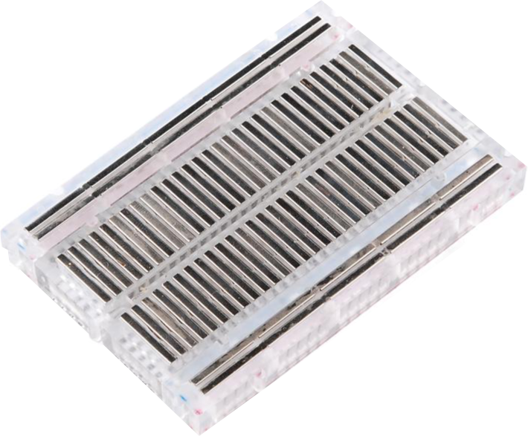
What’s a Breadboard?

Slide 7
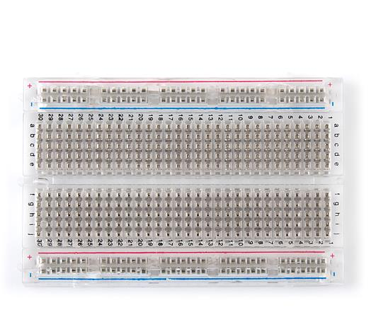
Solderless Breadboard
Each row (horiz.) of 5 holes are connected.
Vertical columns – called power bus are connected vertically

Slide 8

Concepts: INPUT vs. OUTPUT
Referenced from the perspective of the microcontroller (electrical board).
Inputs is a signal / information going into the board.
Output is any signal exiting the board.
Almost all systems that use physical computing will have some form of output
What are some examples of Outputs?

Slide 9
Concepts: INPUT vs. OUTPUT
Referenced from the perspective of the microcontroller (electrical board).
Inputs is a signal / information going into the board.
Output is any signal exiting the board.
Examples: Buttons Switches, Light Sensors, Flex Sensors, Humidity Sensors, Temperature Sensors…
Examples: LEDs, DC motor, servo motor, a piezo buzzer, relay, an RGB LED

Slide 10
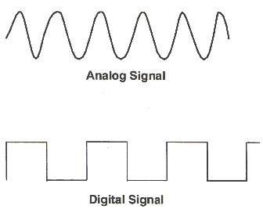
Concepts: Analog vs. Digital
Microcontrollers are digital devices – ON or OFF. Also called – discrete.
analog signals are anything that can be a full range of values. What are some examples? More on this later…
5 V
5 V
0 V
0 V

Slide 11
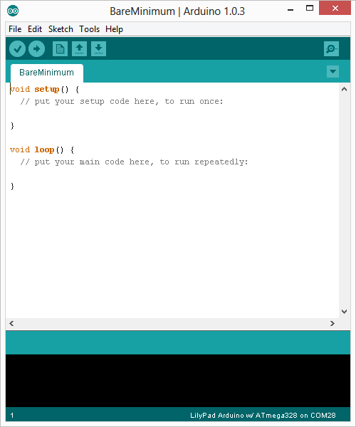
Arduino Integrated Development Environment (IDE)
Two required functions / methods / routines:
void setup()
{
// runs once
}
void loop()
{
// repeats
}
error & status messages
Notes:
Be sure to point out the what all of the buttons do.

Slide 12
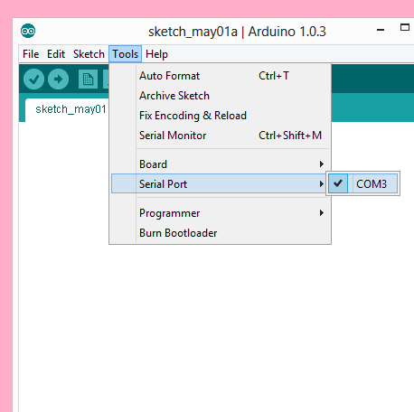
Settings: Tools → Serial Port
Your computer communicates to the Arduino microcontroller via a serial port → through a USB-Serial adapter.
Check to make sure that the drivers are properly installed.
Notes:
All connections to computers- mice, printers etc use a serial port. Gotta pick the right one.

Slide 13
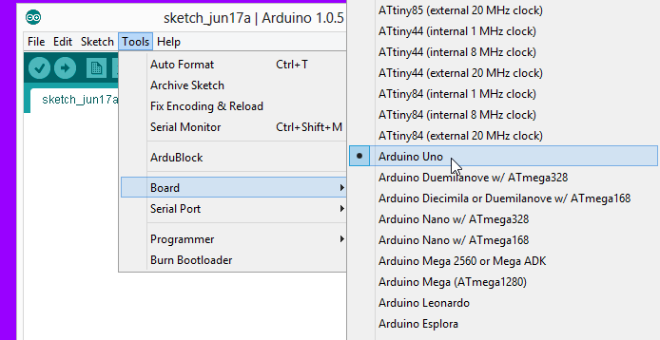
Settings: Tools → Board
Next, double-check that the proper board is selected under the Tools→Board menu.
Notes:
All connections to computers- mice, printers etc use a serial port. Gotta pick the right one.

Slide 14
digitalWrite()
analogWrite()
digitalRead()
if() statements / Boolean
analogRead()
Serial communication
BIG 6 CONCEPTS
This work is licensed under a Creative Commons Attribution-ShareAlike 3.0 United States License.

Slide 15
Let’s get to coding…
Project #1 – Blink
“Hello World” of Physical Computing
Psuedo-code – how should this work?
Turn LED ON
Wait
Turn LED OFF
Wait
Rinse & Repeat

Slide 16
Comments, Comments, Comments
Comments are for you – the programmer and your friends…or anyone else human that might read your code.
// this is for single line comments
// it’s good to put a description at the top and before anything ‘tricky’
/* this is for multi-line comments
Like this…
And this….
*/

Slide 17
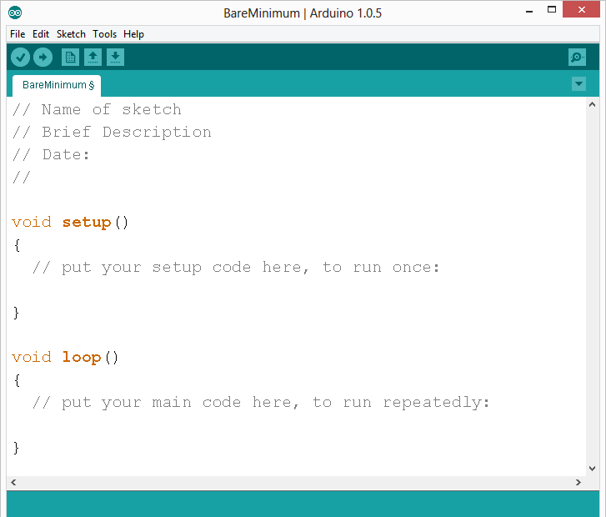
comments
Notes:
Review the two main parts of the sketch – void setup() and void loop()
Provide rationale for good commenting.
Emphasize the need for good / clean coding practices like indenting.

Slide 18
Three commands to know…
pinMode(pin, INPUT/OUTPUT);
ex: pinMode(13, OUTPUT);
digitalWrite(pin, HIGH/LOW);
ex: digitalWrite(13, HIGH);
delay(time_ms);
ex: delay(2500); // delay of 2.5 sec.
// NOTE: -> commands are CASE-sensitive
Notes:
Three commands to rule the world… or at least do 80% of cool Arduino projects.

Slide 19
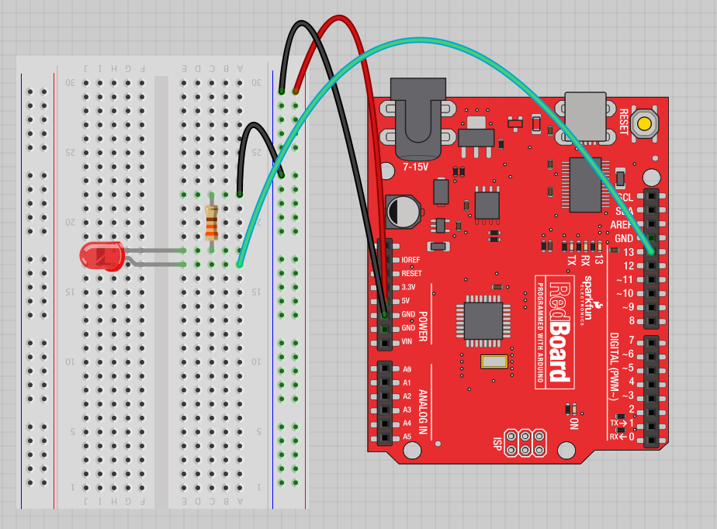
Project #1: Wiring Diagram
Move the green wire from the power bus to pin 13 (or any other Digital I/O pin on the Arduino board.
Image created in Fritzing

Slide 20
A few simple challenges Let’s make LED#13 blink!
Challenge 1a – blink with a 200 ms second interval.
Challenge 1b – blink to mimic a heartbeat
Challenge 1c – find the fastest blink that the human eye can still detect…
1 ms delay? 2 ms delay? 3 ms delay???

Slide 21
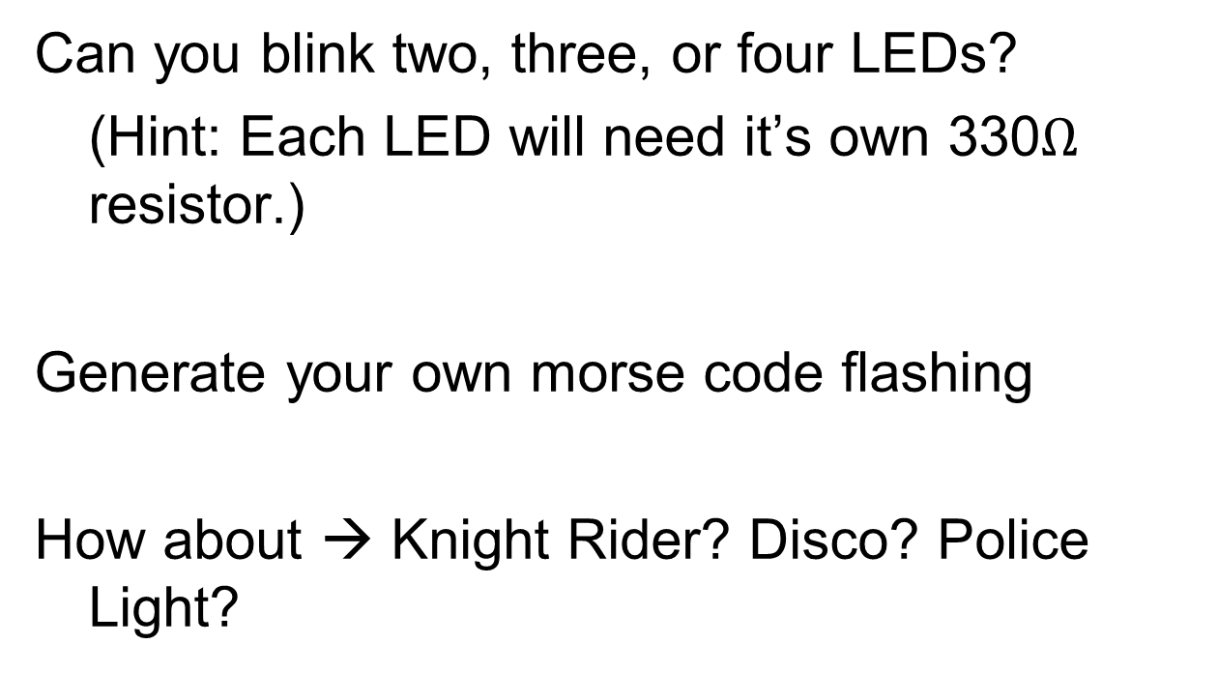
Try adding other LEDs

Slide 22
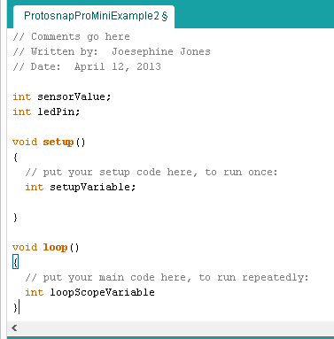
Programming Concepts: Variables
Variable Scope
Global
---
Function-level

Slide 23



Programming Concepts: Variable Types
Variable Types:
8 bits
16 bits
32 bits
byte
char
int
unsigned int
long
unsigned long
float

Slide 24
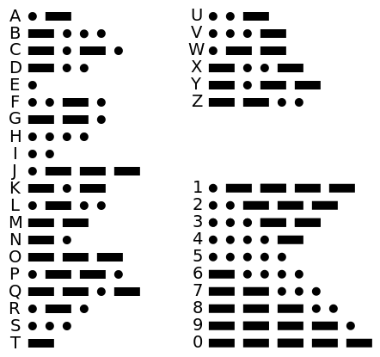
MMorse Code..(use 200ms delay to represent '.' and 700ms delay to represent '-').... Represent 'SOS'

Slide 25
Exercises to do...before next workshop
Use Morse code to display a message.
Use 2 or more leds to display patterns/disco lights etc.
Read analog input output.
Read Serial input/output.

Slide 26

Questions?

